Slide 1

Merme Generator 3000
by Nicolas Di Costanzo

Slide 2
What is a meme?
What is a meme?
Image taken out of context and associated with new situation for humorous purposes
Image taken out of context and associated with new situation for humorous purposes

Slide 3

Type of memes I would use

Slide 4

Reaction

Slide 5

Illustration

Slide 6
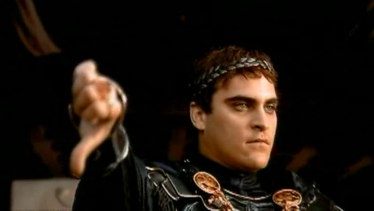
Types of memes I would exclude

Slide 7
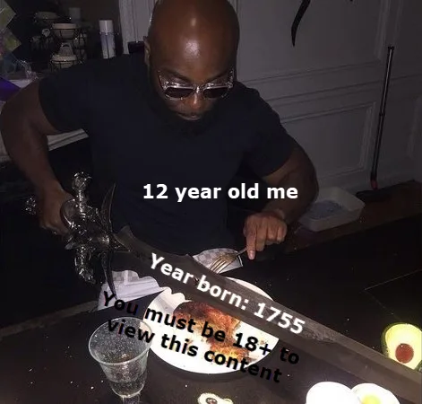
Too specific

Slide 8
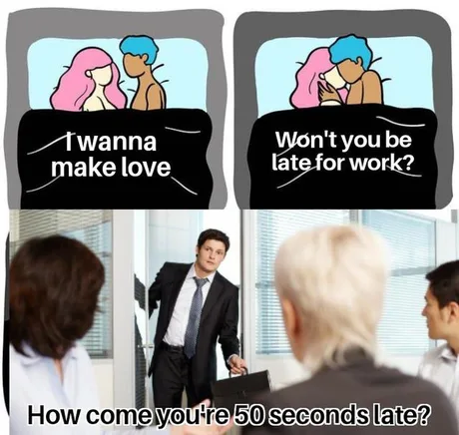
Would need other image(s)

Slide 9
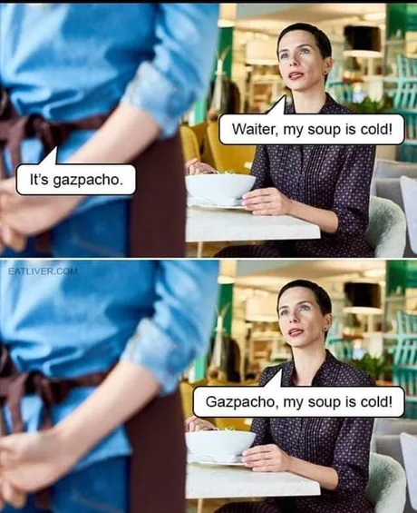
Jokes

Slide 10
Why is this project relevant?
Lot of resources
Funny
Few technical difficulties

Slide 11

My concerns

Slide 12
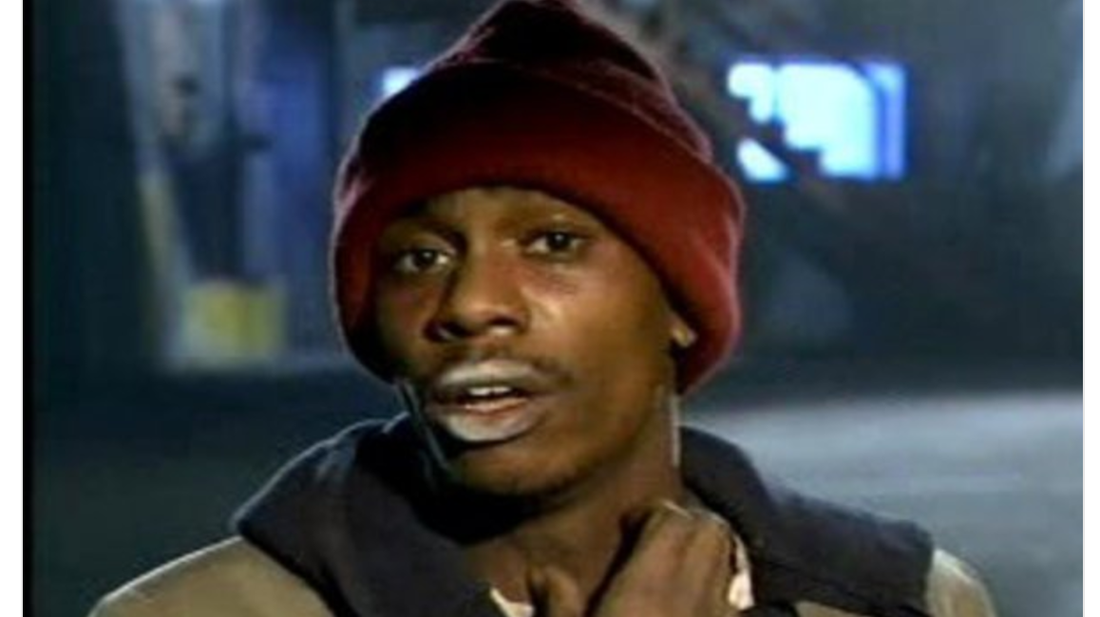
YALL GOT ANY QUESTION OR REMARKS?

